Slide 1

Operating systems
I/O Management, System Protection and Security
Venkatesh Prasad
Department of Computer Science

Slide 2
Operating systems
System Security - Program Threats
Venkatesh Prasad
Department of Computer Science
Notes:
To discuss security threats and attacks

Slide 3
OPERATING SYSTEMS
Slides Credits for all PPTs of this course
The slides/diagrams in this course are an adaptation, combination, and enhancement of material from the following resources and persons:
Slides of Operating System Concepts, Abraham Silberschatz, Peter Baer Galvin, Greg Gagne - 9th edition 2013 and some slides from 10th edition 2018
Some conceptual text and diagram from Operating Systems - Internals and Design Principles, William Stallings, 9th edition 2018
Some presentation transcripts from A. Frank – P. Weisberg
Some conceptual text from Operating Systems: Three Easy Pieces, Remzi Arpaci-Dusseau, Andrea Arpaci Dusseau

Slide 4
OPERATING SYSTEMS
Program Threats
Many variations, many names
Trojan Horse
Code segment that misuses its environment
Exploits mechanisms for allowing programs written by users to be executed by other users
Spyware, pop-up browser windows, covert channels
Up to 80% of spam delivered by spyware-infected systems
Trap Door
Specific user identifier or password that circumvents normal security procedures
Could be included in a compiler
How to detect them?

Slide 5
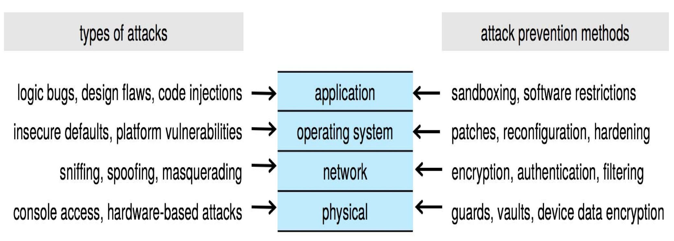
OPERATING SYSTEMS
Four-layered Model of Security

Slide 6
OPERATING SYSTEMS
Program Threats (Cont.)
Logic Bomb
Program that initiates a security incident under certain circumstances
Stack and Buffer Overflow
Exploits a bug in a program (overflow either the stack or memory buffers)
Failure to check bounds on inputs, arguments
Write past arguments on the stack into the return address on stack
When routine returns from call, returns to hacked address
Pointed to code loaded onto stack that executes malicious code
Unauthorized user or privilege escalation

Slide 7
OPERATING SYSTEMS
C Program with Buffer-overflow Condition
#include <stdio.h>
#define BUFFER SIZE 256
int main(int argc, char *argv[])
{
char buffer[BUFFER SIZE];
if (argc < 2)
return -1;
else {
strcpy(buffer, argv[1]);
return 0;
}
}
Strncpy() can help
Code review can help – programmers review each other’s code, looking for logic flaws, programming flaws
Notes:
strcpy( ) function copies whole content of one string into another string whereas, strncpy( ) function copies
a portion of contents (at most n bytes) of one string into another string.
strncpy( ) combats buffer overflow by requiring us to put a length in it. Strcpy() depends on a trailing \0, which may not always occur.

Slide 8
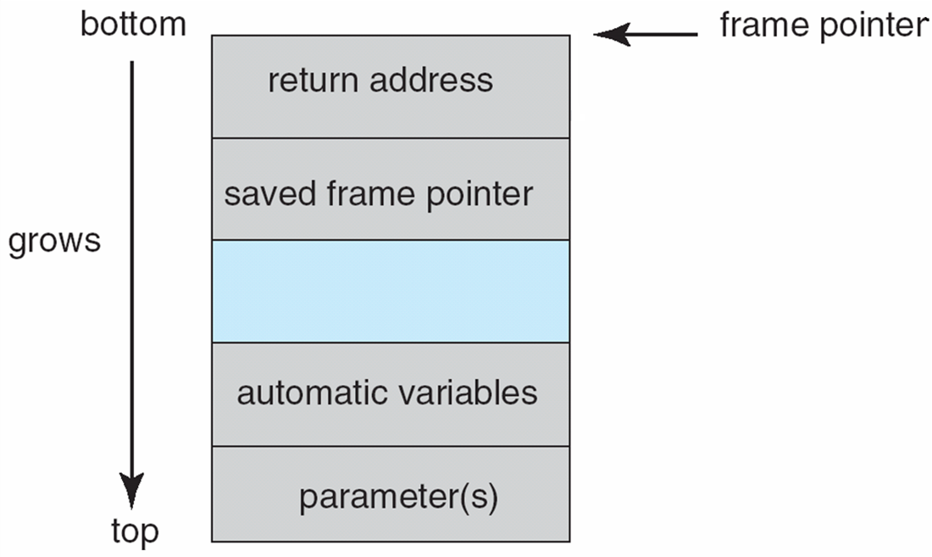
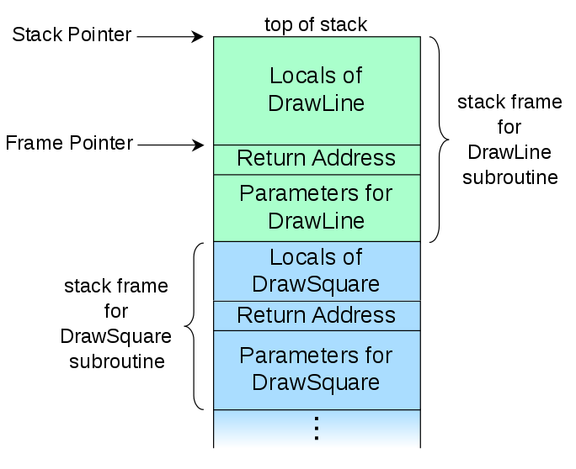
OPERATING SYSTEMS
Layout of Typical Stack Frame
Frame pointer is the address of the beginning of the stack frame.
It is saved on the stack, as the value of the SP can vary during the function call.

Slide 9
OPERATING SYSTEMS
Modified Shell Code
Using the execvp() system call, this code segment creates a shell process.
If the program being attacked runs with system-wide permissions, this newly created shell will gain complete access to the system.
#include <stdio.h>
int main(int argc, char *argv[])
{
execvp(‘‘\bin\sh’’,‘‘\bin \sh’’, NULL);
return 0;
}

Slide 10
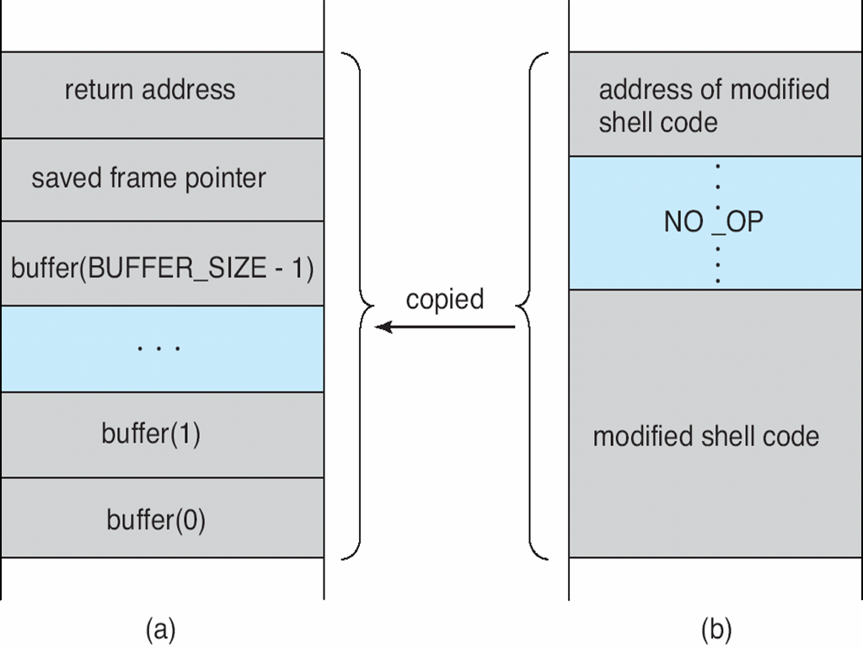
OPERATING SYSTEMS
Hypothetical Stack Frame
Before attack
After attack

Slide 11
OPERATING SYSTEMS
Great Programming Required?
For the first step of determining the bug, and second step of writing exploit code, yes
Script kiddies can run pre-written exploit code to attack a given system
Attack code can get a shell with the processes’ owner’s permissions
Or open a network port, delete files, download a program, etc
Depending on bug, attack can be executed across a network using allowed connections, bypassing firewalls
Buffer overflow can be disabled by disabling stack execution or adding bit to page table to indicate “non-executable” state
Available in SPARC and x86
But still have security exploits

Slide 12
OPERATING SYSTEMS
Program Threats (Cont.)
Viruses
Virus is a fragment of code embedded in a legitimate program
Self-replicating, designed to infect other computers
Very specific to CPU architecture, operating system, applications
Usually borne via email or as a macro
Visual Basic Macro to reformat hard drive of a Windows computer as soon as the macro file is opened
Sub AutoOpen()
Dim oFS
Set oFS = CreateObject(’’Scripting.FileSystemObject’’)
vs = Shell(’’c:command.com /k format c:’’,vbHide)
End Sub

Slide 13
OPERATING SYSTEMS
Program Threats (Cont.)
Virus dropper inserts/launches virus onto the system
Many categories of viruses, literally many thousands of viruses
File / parasitic virus – appends itself to a file, changes execution start or order of the program
Boot / memory virus – infects boot sector, infects bootable media, do not appear in the file system
Macro – written in high language such as Visual Basic
Source code – modifies source code to include a call to some malicious code, spreads virus
Polymorphic – changes virus signature (identity pattern) each time it is installed to avoid detection by antivirus software
A polymorphic virus decrypts its code, runs that code, and then when propagating itself encrypts the decrypted code with a different key.
A metamorphic virus simply runs its code and then when propagating itself mutates its code into different but functionally identical code.

Slide 14
OPERATING SYSTEMS
Program Threats (Cont.)
Encrypted – includes encrypted virus and decryption code
Stealth –hidden computer virus that attacks processes and averts typical anti-virus or anti-malware scans,
hides in files, partitions and boot sectors
adept at deliberately avoiding detection.
Tunneling – installs itself in interrupt-handler chain and device drivers
Multipartite – infects multiple parts of a system such as boot sectors, memory and files
Armored – fools antivirus software from disclosing its actual location, adds complicated/confusing code

Slide 15
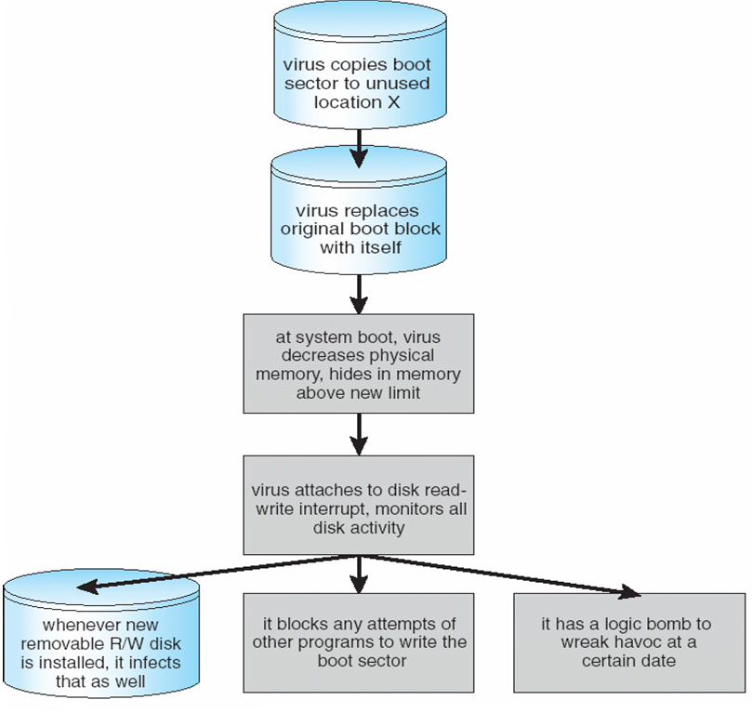
OPERATING SYSTEMS
A Boot-sector Computer Virus

Slide 16
OPERATING SYSTEMS
The Threat Continues
Attacks still common, still occurring
Attacks moved over time from science experiments to tools of organized crime
Targeting specific companies
Creating botnets to use as tool for spam and DDOS delivery
Keystroke logger to grab passwords, credit card numbers
Why is Windows the target for most attacks?
Most common
Everyone is an administrator
Licensing required?
Monoculture considered harmful
Notes:
Monoculture - many systems run the same hardware, operating system, and application software.
This monoculture supposedly consists of Microsoft products.

Slide 17

THANK YOU
Venkatesh Prasad
Department of Computer Science Engineering
venkateshprasad@pes.edu

